Slide 1


CS3003: Functional Programming

Slide 2
Characteristics
There is no state
Functions are central
Functions can be parameters to other functions
Functions can be return values from other others
Program execution is function evaluation
Control flow is performed by recursion and conditional expressions
Lists are a fundamental data type

Slide 3
Lambda Calculus
Theoretical basis of functional programming languages
Just like how the Turing Machine is the theoretical basis of the imperative programming languages

Slide 4
Lambda Calculus
The entirety of the Lambda Calculus is made up of three entities:
1. Expression: a name, a function or an application
2. Function: λ<name> . <expression>
3. Application: <expression> <expression>

Slide 5
Examples
λx.x
(λx.x) 3

Slide 6
Bound and Free Names
(λa.a) x
(λa.a)

Slide 7
Bound and Free Names
(λa.a) x

Slide 8
Bound and Free Names
(λa. λb. ba)

Slide 9
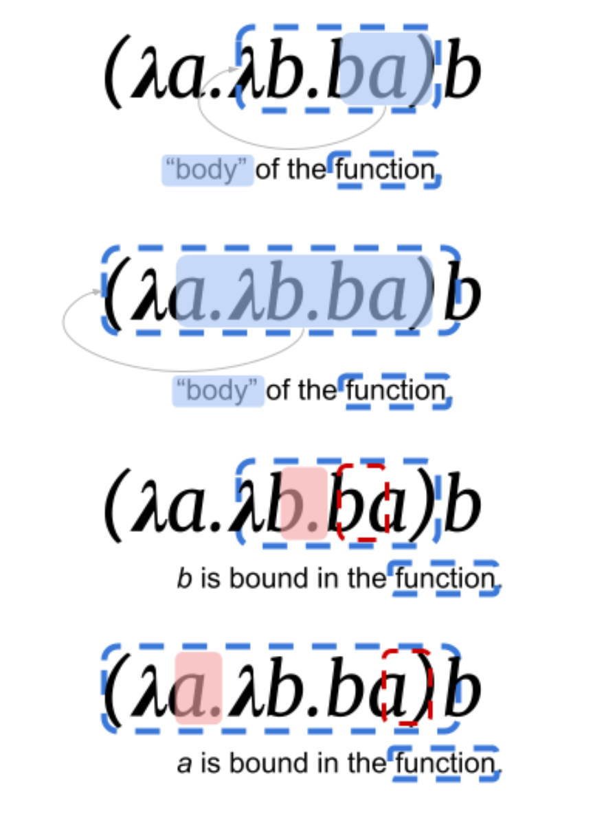
Bound and Free Names

Slide 10
Bound and Free Names
(λx. xλx. x)

Slide 11
Alpha Conversion
(λx. xλa. a)

Slide 12
Bound Variable
(λx.x)

Slide 13
Free Variable
(λx.x)(λy.yx)

Slide 14
Free Variable
<name> is free in <name>
<name> is free in λ <name1>.<exp> if <name> != <name1> and <name> is free in <exp>
<name> is free in E1E2 if <name> is free in E1 or in E2

Slide 15
Free Variable Examples
a is free in a
y is free in λx.y
x is free in (λx.x)x

Slide 16
Bound Variable
<name> is bound in λ<name1>.<exp> if <name> = <name1> or if <name> is bound in <exp>
<name> is bound in E1E2 if <name> is bound in E1 or E2

Slide 17
Bound Variable Examples
x is bound in (λy.(λx.x))
x is bound in (λx.x)x

Slide 18
Substitution Rules
A free variable should not be substituted in a subexpression where it is bound
(λx.(λy.xy))y

Slide 19
Substitution Rules
Use alpha conversion
(λx.(λy.xy))y

Slide 20
Example
(λx.(λy.(x(λx.xy))))y

Slide 21
Examples
(λx.λy.x)
(λx.λy.y)

Slide 22
Example - NOT
(λb.b F T)

Slide 23
Example - AND
(λx. λy. x y F)

Slide 24
Example - OR

Slide 25
Currying Functions

Slide 26
Closures

Slide 27
Applicative order vs Normal order
dbl x = (+) x x
average a b c = (/) ((+) a ((+) b c)) 3

Slide 28
Normal order
dbl (average 3 4 5)

Slide 29
Normal order
dbl (average 3 4 5)
+ (average 3 4 5) (average 3 4 5)
+ ((/) ((+) 3 ((+) 4 5)) 3) (average 3 4 5)
+ (4) (average 3 4 5)
+ (4) ((/) ((+) 3 ((+) 4 5)) 3)
+ (4) (4)
8

Slide 30
Applicative order
dbl (average 3 4 5)
dbl ((/) ((+) 3 ((+) 4 5)) 3)
dbl 4
+ 4 4
8

Slide 31
Implications of Applicative order

Slide 32
Thunk
a thunk is created for (average 3 4 5),
that thunk is passed to dbl, where it is duplicated during the reduction of dbl,
(average 3 4 5) is (eventually) calculated when the value of (average 3 4 5) is needed,
4 is stored (cached, memoized) in the thunk, and
the cached/memoized value is retrieved from the thunk instead of doing a fresh evaluation the next time that the value of (average 3 4 5)is needed.

